Slide 1




VISIONEXTRACT
Isolation from Images using Image Segmentation

Slide 2



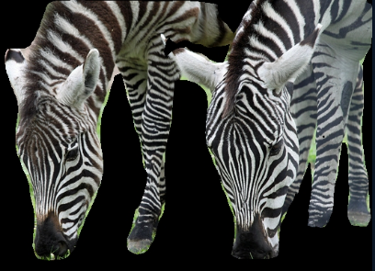
PROBLEM STATEMENT
The goal of this project is to build a machine learning model capable of automatically extracting the main subject from an image. For any given input picture, the model should output a new image in which only the subject is visible and everything else is rendered completely black. This subject isolation process can be used for automation in photography, digital art, augmented reality, virtual conferencing, and background replacement applications.

Slide 3

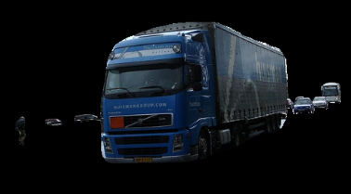
BACKGROUND
VisionExtract focuses on image segmentation for subject isolation.
Manual background removal is time-consuming and inefficient.
Automated extraction is crucial in photography, AR/VR, digital art, and video conferencing.
The project aims to build a model that outputs an image with only the subject visible, background blacked out.
Impact: Enables faster editing workflows, supports creative industries, and enhances real-time applications.

Slide 4
OBJECTIVE
OBJECTIVE 01
OBJECTIVE 02
OBJECTIVE 03
OBJECTIVE 04
Evaluate performance using IoU, Dice, Precision, and Recall metrics.
Visualize input vs. ground truth vs. predicted masks for clarity.
Develop a deep learning model for subject isolation using image segmentation.
Implement data preprocessing to align images and masks accurately
Train and fine-tune the model for high accuracy (IoU, Dice coefficient).
Generate binary masks to separate subject vs. background
Visualize and compare original images, masks, and predictions.
Deploy a pipeline for real-time subject extraction on new images.

Slide 5
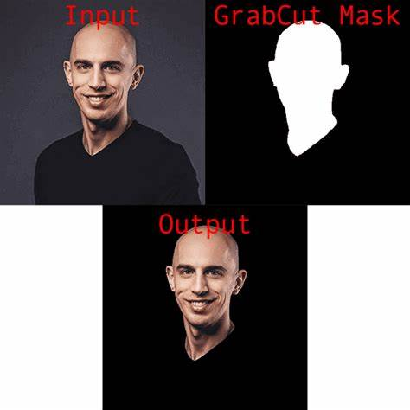
SOLUTION 01
Manual Background Removal
Tools like Photoshop, Canva, and online background removers.
EXISTING SOLUTIONS
SOLUTION 02
Classical Computer Vision Techniques
Thresholding, Edge Detection, GrabCut, Watershed.
SOLUTION 03
Pre-trained Segmentation Models
Models like Mask R-CNN, U-Net, DeepLab.

Slide 6
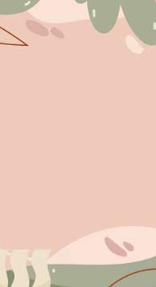
PROPOSED SOLUTION
DATASET PREPARATION
MODEL DESIGN
TRAINING STRATEGY
EVALUATION
DEPLOYMENT PIPELINE
USE COCO 2017 DATASET (IMAGES + MASK ANNOTATIONS).
Preprocess: resize, normalize, and augment images.
Convert multi-class masks → binary subject-background masks
BASE ARCHITECTURE: U-NET / DEEPLAB / MASK R-CNN.
Add custom layers to adapt to subject isolation task.
Lightweight and optimized for fast inference.
TRAIN ON PREPARED DATASET WITH OPTIMIZED HYPERPARAMETERS.
Use cross-entropy + Dice loss for pixel-wise segmentation.
Monitor IoU, Dice, and pixel accuracy during training.
COMPARE PREDICTED MASKS VS GROUND TRUTH.
Quantitative metrics (IoU, Dice, Precision, Recall).
Qualitative visuals: original image → mask → isolated subject.
BUILD AN AUTOMATED PIPELINE: IMAGE UPLOAD → PREPROCESSING → MODEL INFERENCE → OUTPUT.
Ensure real-time subject isolation capability.

Slide 7
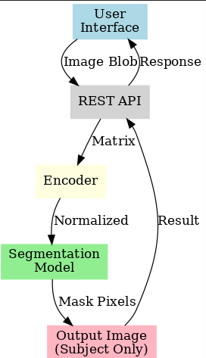
DATASET
THE PROJECT USES THE COCO 2017 DATASET, WHICH PROVIDES A LARGE COLLECTION OF REAL-WORLD IMAGES ALONG WITH CORRESPONDING SEGMENTATION MASKS. THESE MASKS ARE UTILIZED TO TRAIN THE MODEL FOR SUBJECT ISOLATION. DURING PREPROCESSING, ALL IMAGES AND MASKS ARE RESIZED TO A UNIFORM RESOLUTION, NORMALIZED FOR CONSISTENT PIXEL VALUES, AND SUBJECTED TO DATA AUGMENTATION TECHNIQUES SUCH AS FLIPPING, CROPPING, AND COLOR PERTURBATIONS TO IMPROVE MODEL GENERALIZATION. THE ORIGINAL MULTI-CLASS MASKS ARE CAREFULLY CONVERTED INTO BINARY MASKS, ENSURING A CLEAR DISTINCTION BETWEEN THE SUBJECT (FOREGROUND) AND BACKGROUND. FOR MODEL VALIDATION, A DEDICATED VALIDATION SUBSET WITH ANNOTATIONS IS USED TO EVALUATE PERFORMANCE AND MONITOR IMPROVEMENTS DURING TRAINING.

Slide 8
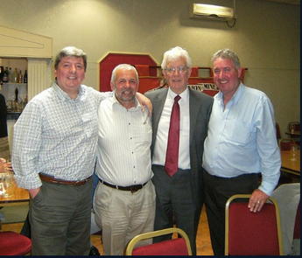
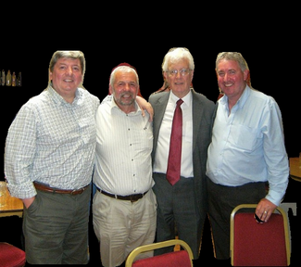
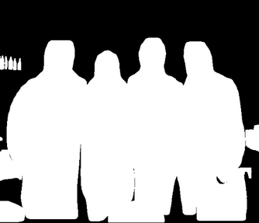
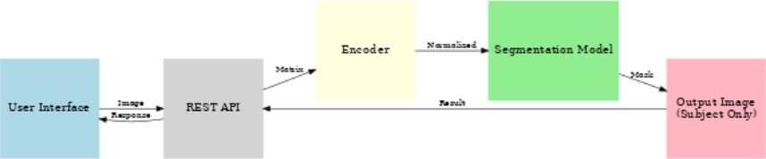
ORIGINAL
COLOR MASKING
BINARY MASKING
FLOWCHART

Slide 9

IMPLEMENTATION
USER INTERFACE (Web Application)
1.) USER UPLOADS AN IMAGE THROUGH A SIMPLE WEB INTERFACE.
2.) mage is sent as a blob via HTTP request.
REST API (Backend)
1.) RECEIVES THE UPLOADED IMAGE..
2.) Converts the blob into a usable image matrix format.
ENCODER
1.) PREPROCESSES AND NORMALIZES THE IMAGE.
2.) Extracts essential features for segmentation.
SEGMENTATION MODEL
1.) A BINARY MASK: SUBJECT (FOREGROUND) VS BACKGROUN
2.) Generates pixel-level classification.
OUTPUT IMAGES
1.) APPLIES MASK → SUBJECT REMAINS, BACKGROUND IS REPLACED WITH BLACK.

Slide 10
ADVANTAGES:
PROVIDES PIXEL-LEVEL ACCURACY FOR OBJECT/SUBJECT SEPARATION.
Essential for medical imaging, AR/VR, autonomous driving, and digital art.
Automates background removal → saves time in editing workflows.
Enables real-time subject extraction in conferencing and virtual reality.
DISADVANTAGES:
REQUIRES LARGE, HIGH-QUALITY DATASETS FOR TRAINING.
Computationally expensive and resource-heavy for real-time use.
Performance can degrade under complex lighting, occlusion, or noise.
Generalization is challenging → model may not work equally well on unseen domains.

Slide 11
INTEGRATION WITH EDGE DEVICES FOR REAL-TIME AR/VR APPLICATIONS.
GENERATIVE AI + SEGMENTATION FOR INTELLIGENT BACKGROUND REPLACEMENT.
DEVELOPMENT OF LIGHTWEIGHT, OPTIMIZED MODELS FOR MOBILE AND IOT.
IMPROVED ACCURACY THROUGH SELF-SUPERVISED & FEW-SHOT LEARNING.
CROSS-DOMAIN GENERALIZATION TO HANDLE DIVERSE IMAGE TYPES AND ENVIRONMENTS.
REAL-TIME DEPLOYMENT IN VIDEO CONFERENCING, GAMING, AND VIRTUAL TRY-ON APPS.
HYBRID MODELS COMBINING SEGMENTATION WITH OBJECT DETECTION FOR RICHER RESULTS.
INTEGRATION WITH CLOUD + EDGE AI PIPELINES FOR SCALABLE GLOBAL DEPLOYMENT.
FUTURE PROSPECTS

Slide 12
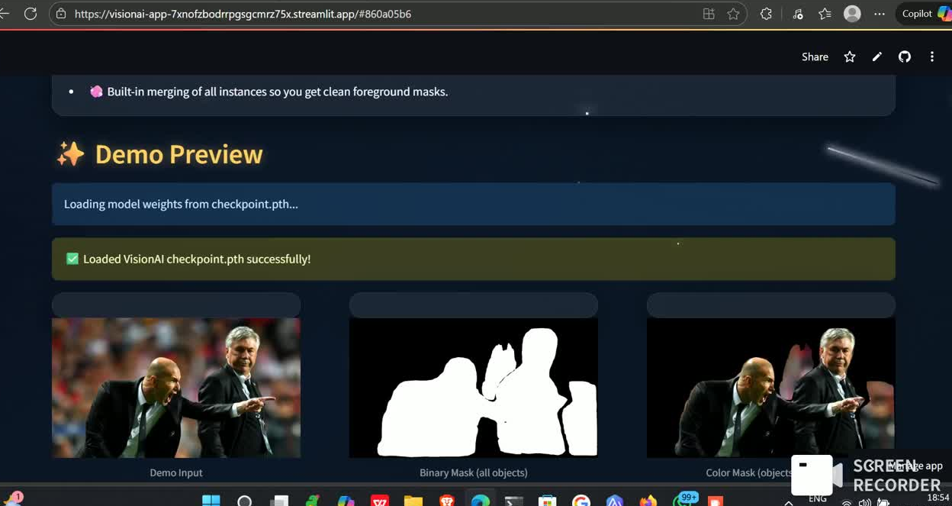

Slide 13
SUCCESSFULLY IMPLEMENTED IMAGE SEGMENTATION FOR SUBJECT ISOLATION.
Demonstrated the power of deep learning in pixel-level accuracy.
Automated workflow reduces manual effort and saves time.
Achieved strong results using IoU, Dice, and accuracy metrics.
Solution shows potential for real-time and industry applications.
Future improvements can make the system more efficient and scalable.
CONCLUSION

Slide 14
THANK YOU

